Slide 1
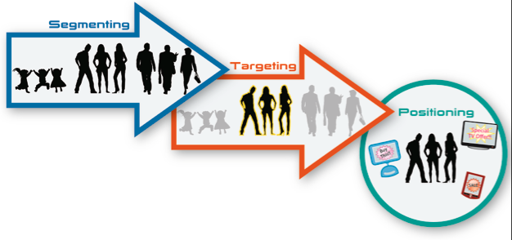
TOPIC 2: SEGMENTATION, TARGETING AND POSITIONING (STP)
https://medium.com/@Prashirsh/segmentation-targeting-positioning-stp-in-marketing-dd848f0e7e95

Slide 2
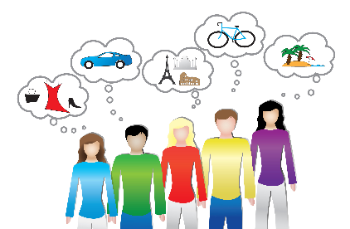
What is a market?
Group of individuals and/or organizations that have a desire/want or a need for a specific product (broader meaning of the word) and have the ability, the willingness and the authority to buy such a product.
Which of the following are:
*needs
*wants
https://smallbusiness.co.uk/tap-consumer-mindset-2536343/

Slide 3
Activity: Possible market and its characteristics
Think of the possible market (see definition of a market previous slide) for the products (services) offered by a traditional university. Explain the following terms, using a specific university as an example, and a prospective average first year student, as your target market.
Needs
Wants
Ability to buy
Willingness to buy
Authority to buy

Slide 4

Segmentation
A university cannot effectively sell its products to the whole potential market. It thus makes sense to divide (segment) the market.
BUT
Remember that each segment must have its own marketing mix (mix of 4Ps, 4As and 4Cs). If a different marketing mix is not required, there is no need for that segment.

Slide 5
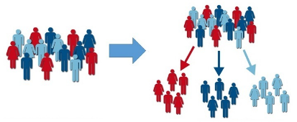
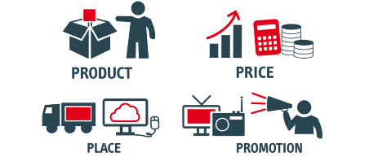
Activity: Different marketing mix for each segment
Watch this short video to get a better understanding of the statement: “each segment requires a unique marketing mix”. The video starts off with a little revision of the 4Ps before it gets to segmentation.
https://www.youtube.com/watch?v=Mco8vBAwOmA&list=LL7njn8fJYDJCUXdqVfVAIng&index=332
https://www.klood.com/blog/inbound/do-you-remember-the-marketing-mix
https://serpstat.com/blog/what-is-targeted-advertising-on-social-networks-and-how-to-configure-it/

Slide 6
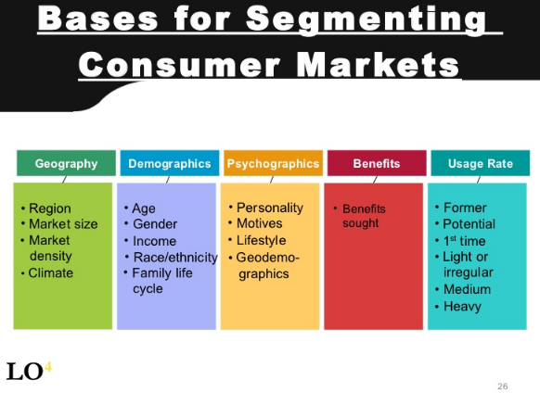
Bases and variables of segmenting the consumer market
Bases
Variables
https://image.slidesharecdn.com/2011-2-08marketing-110719011121-phpapp01/95/2011208-marketing-26-728.jpg?cb=1311038000

Slide 7

Criteria for “good” segments
Homogeneous
Heterogeneous
Substantial
Measurable
Accessible
Responsive

Slide 8
Targeting
Must decide which segments to target. Three basic options:
Undifferentiated targeting strategy - organization defines an entire market for a particular product as its target market, designs a single marketing mix, and directs it at the entire market (whole market is viewed as one segment).
Assumes that needs of the target market for specific kinds of products are very similar (homogeneous); thus, the business can satisfy most customers with a single marketing mix (same product, price, promotion).

Slide 9
Targeting
Concentrated targeting strategy - organization targets a single segment (one small, often specialized section, called a niche) using one marketing mix. Specialised products such as wheelchairs for handicapped playing a specific sport.
Specialization gives the organization an opportunity to carefully analyze the characteristics and needs of a distinct customer group and then focus all marketing efforts on satisfying that group’s needs.
Helps org with restricted resources to compete with much larger organizations that might focus only a small percentage of its activities on the specific segment.
However, if the segment’s demand for the product declines, org may have problems as it did not diversify into other segments.

Slide 10
Targeting
Differentiated targeting strategy - organization targets two or more segments by developing a different marketing mix for each segment. Examples?
Can increase its sales in a total market by focusing on more than one segment – different marketing mixes aimed at different groups of people.
If not successful in one segment, can still make profits in other segment(s).
Sales to additional market segments may absorb excess production capacity with minor changes to product. However, a greater number of production processes, materials, and skills might increase production costs.

Slide 11

Positioning
Once the organization has decided on a segment (segments) to target, the next step is to develop a positioning strategy.
Product position = is the “place” the product/brand occupies in the consumer’s mind; how the consumer “sees” the product relative to other products or to competitors’ products or brands.
https://medium.com/@afrench53198/defining-brand-positioning-a4e6092c7943

Slide 12
Activity: Positioning
Which products/brands come(s) to mind when you think of the following:
Safe and reliable car
Expensive car
Effective energy drink
Innovative cell phone and electronics company
These attributes help “position” the product or brand in the consumer’s mind relative to competitors’ products, in other words, the attributes that differentiate a product from competitive products or the major attributes the consumer associates the product with.

Slide 13
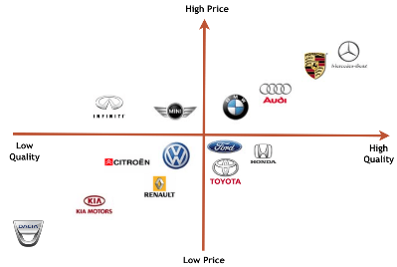
Perceptual maps
A perceptual map is essentially a market research technique, used to plot consumers’ views of a product, business or brand relative to other products, businesses or brands.
The map can also help one identifies a “gap in the market” based on chosen product attributes.
(see next slide)
https://corporatefinanceinstitute.com/resources/knowledge/strategy/market-positioning/

Slide 14
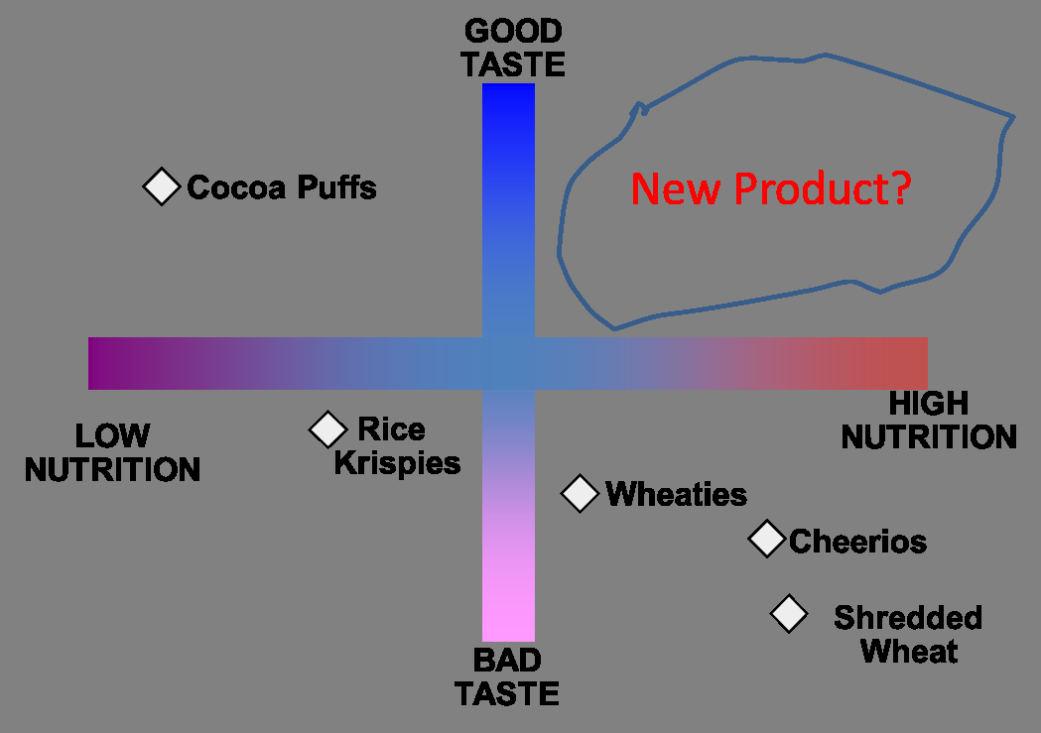
Positioning map
https://www.bing.com/images/search?view=detailV2&ccid=PavTEdCI&id=61C476ACD2F3DCBDBF5459B4A92E651CB1ECB94E&thid=OIP.PavTEdCIIomRryDVHFYiuAHaFN&mediaurl=https%3a%2f%2fassets.entrepreneur.com%2farticle%2f1433187933_1433155809_Picture2.png&exph=739&expw=1049&q=Perceptual+Map+Marketing&simid=607987822645086357&ck=451BC481B3D6601B670116696FD4DB01&selectedIndex=15&FORM=IRPRST

Slide 15
Activity: Perceptual map
Draw a perceptual positioning map placing the four breakfast options below on the map.
Use the following variables: cost and time to prepare
bowl of cereal with cold milk
full English breakfast
bowl of cooked porridge
glass of expensive imported fruit shake poured from a bottle.
Is there a gap in the market?

Slide 16
Changing a product’s position or perception in the consumer’s mind
What is your association with the following brands?
Java
Colgate
Nintendo
Google

Slide 17
Repositioning
Repositioning refers to the process of altering the existing space its offering occupies in the minds of customers, i.e. it is a process of changing how the target market perceives the offering with respect to its features and competitors.

Slide 18
Repositioning typically focuses on:
Changing the identity (rebranding):
Person: change identity (physical look). Examples?
Product/brand: changes its colours, logo, name, tagline, etc. Examples?
Changing personality, values, behavior, inner taints (Repositioning)
Brand personality – similar to human characteristics
Product/brand: brands changes its values (environmentally oriented), personality (human characteristics such as e.g. reliable - Mercedes, masculine – Old Spice, innovative - Apple), or anything that’s required to change the current perception of the brand.

Slide 19
Thank you!
https://medium.com/@Prashirsh/segmentation-targeting-positioning-stp-in-marketing-dd848f0e7e95

